Slide 1
LogiTest Presentation
Xinyue Yu

Slide 2
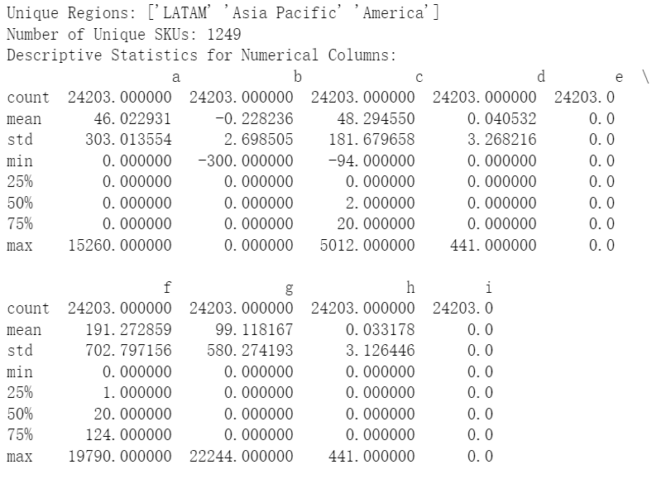
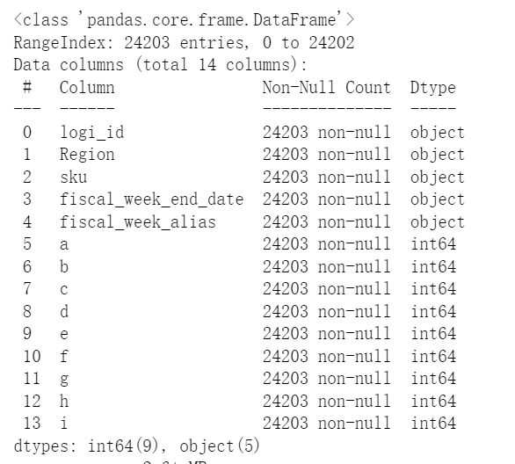
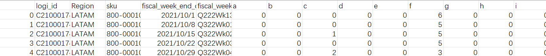
Part 1, Supply Chain Dataset: sc_data.csv
Type transformation

Slide 3
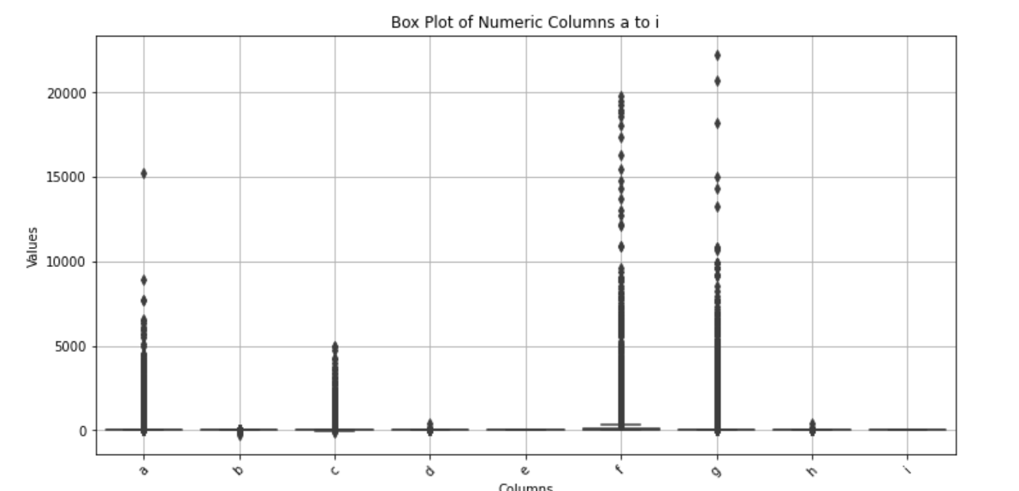
Notes:
whiskers.

Slide 4


Part 2: Product Data Analysis
DataFrame
df_pl
df_dt
df_add
Product Line Data
Store Sales Data
Store Address Data
df_pl.csv
df_dt.csv
df_add.csv

Slide 5
1) Join Data Sets
Product Line Data
Store Sales Data
Product Line Desc
Parent Store Number
Monthly Sales Data
Product SKU
Check if all SKUs in df_dt are in df_pl and all SKUs in df_pl are in df_dt.

Slide 6
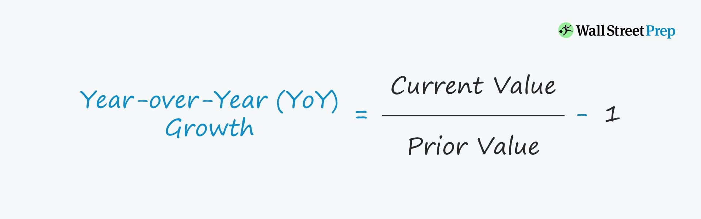
2) YoY growth by month of the product lines
YoY Growth rate=(Current Year Sales by month−Previous Year Sales by month)/
Previous Year Sales by month
calculate_yoy_growth(data)
To Visualize this trend:
Heatmap, Line Chart, Stacked Bar Chart.

Slide 7
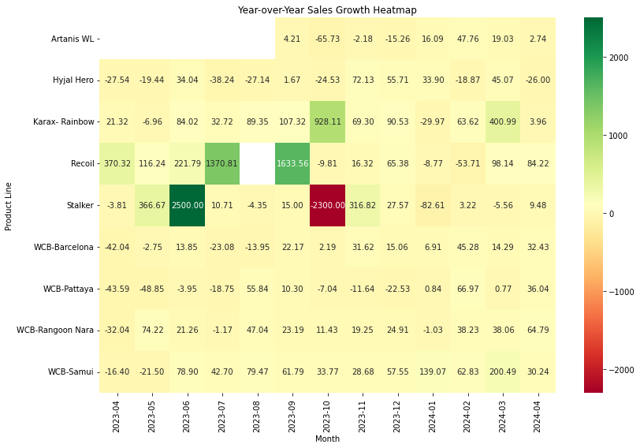
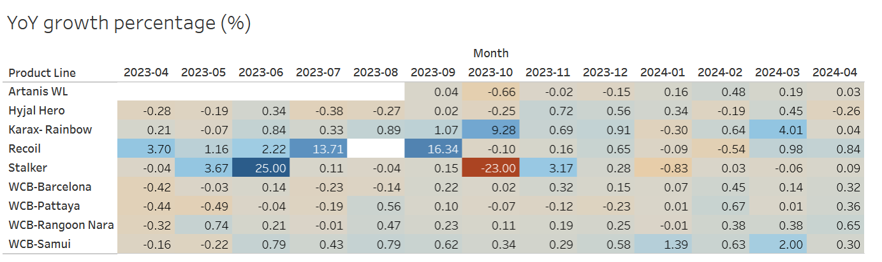
2) Product Line YoY Growth by month Visualization
Heatmap

Slide 8
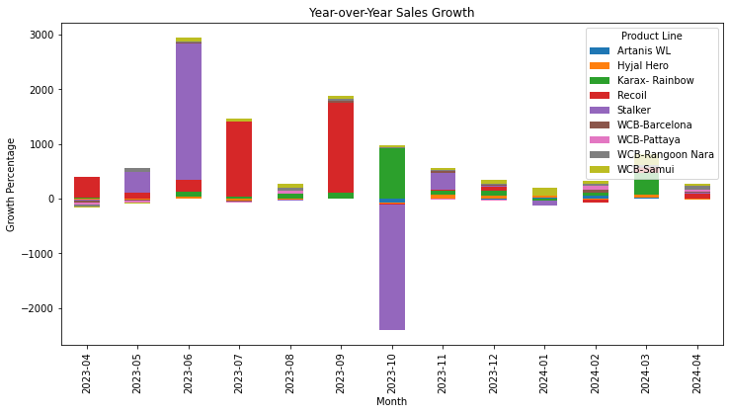
2) Product Line YoY Growth by month Visualization
Stacked Bar Chart

Slide 9
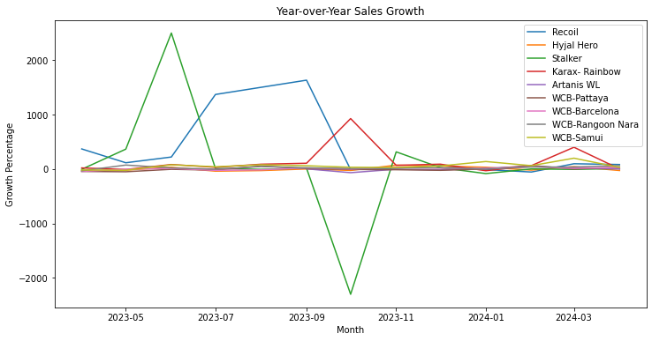
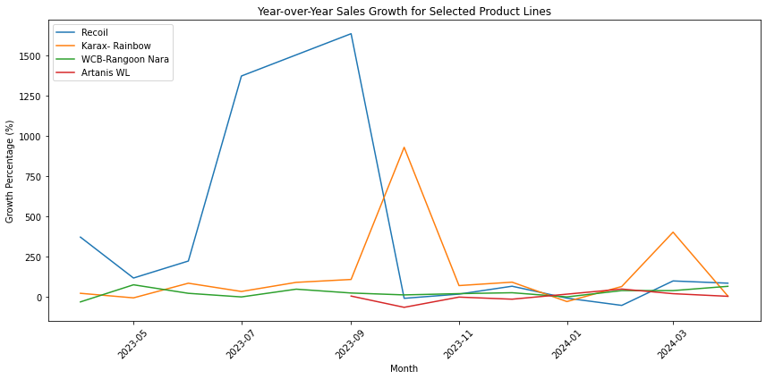
2) Product Line YoY Growth by month Visualization
Line Charts
Notes:
remove the outliers
-26, 26, 9
16,13

Slide 10
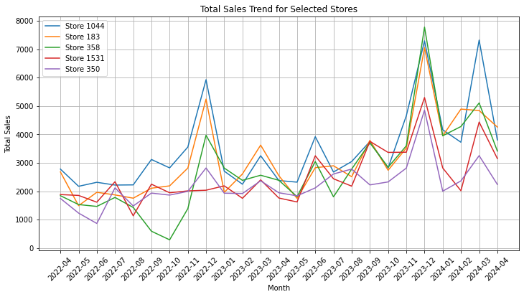
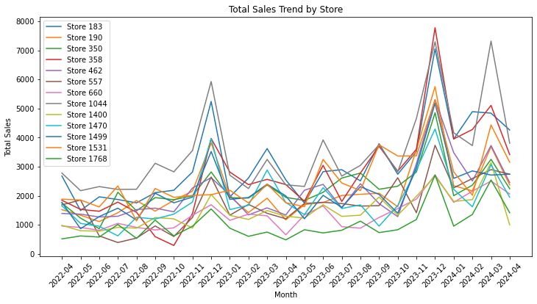
3) Total Sales Visualization
Line Charts
Notes:
For example, Store 1044 and Store 183 generally have higher sales compared to the other stores throughout the period.

Slide 11

3) Inferences From Data
Growth Trends:
Overall, relatively stable or slightly increasing.
Seasonality:
Peaks near end of year.
(Promotions, holidays…)
Variability:
Store-specific factors.
(Location, target market, or store-level strategies)

Slide 12
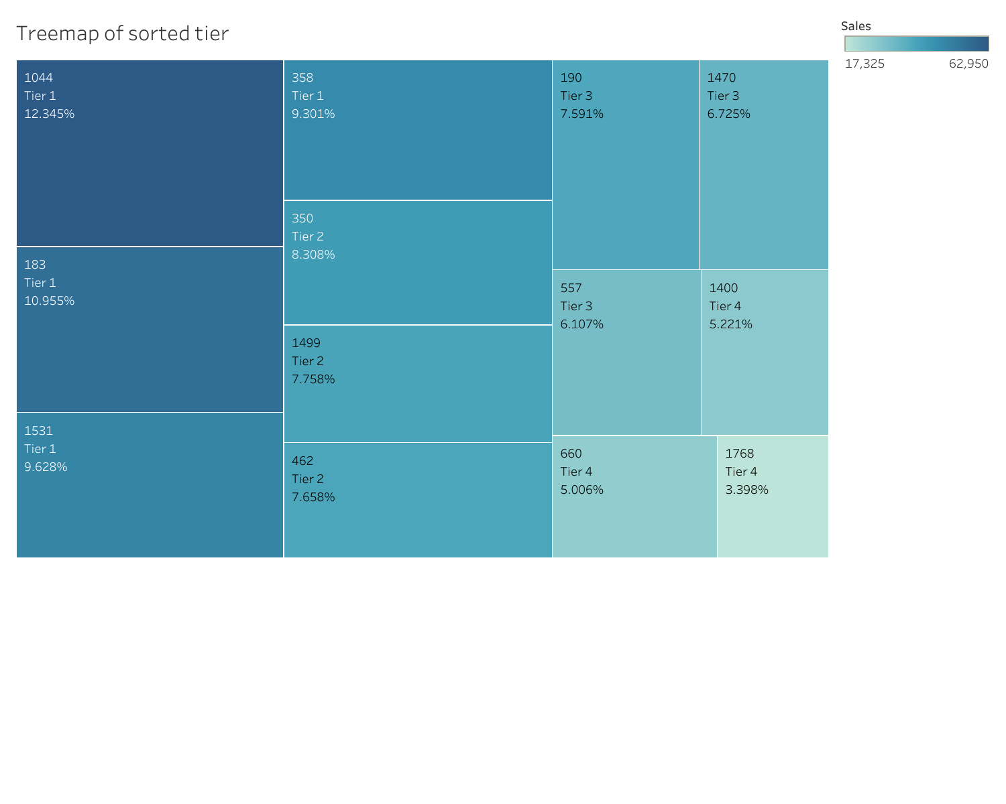
4) Tier Store Level Performance
Parent Store Number Sales Tier
7 1044 62950 Tier 1
0 183 55861 Tier 1
11 1531 49093 Tier 1
3 358 47427 Tier 1
2 350 42365 Tier 2
10 1499 39559 Tier 2
4 462 39052 Tier 2
1 190 38706 Tier 3
9 1470 34290 Tier 3
5 557 31143 Tier 3
8 1400 26624 Tier 4
6 660 25524 Tier 4
12 1768 17325 Tier 4

Slide 13
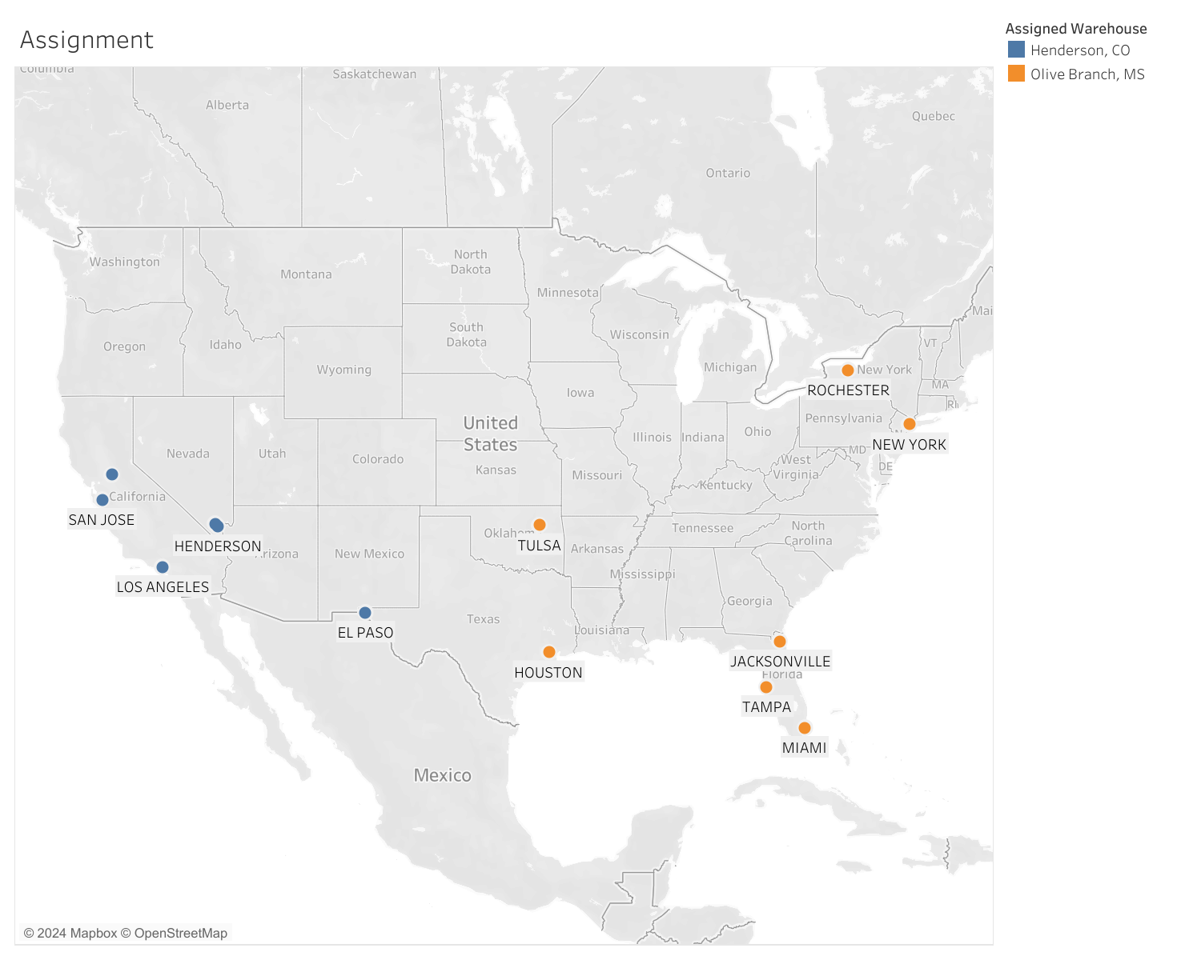

5) Store-Warehouse Selection
OpenCage - get Coordinates of stores
from geopy.distance import geodesic - get Distances from stores to warehouses

Slide 14
Thank You

